Slide 1
Recruiting Young Members
Sarah Duwe
Badger NAMA President
Notes:
Good morning! We’re going to start by taking a look at some of our recruitment numbers, talk about how we engage with and recruit students, and how social media plays into our “young professional” crowd.

Slide 2
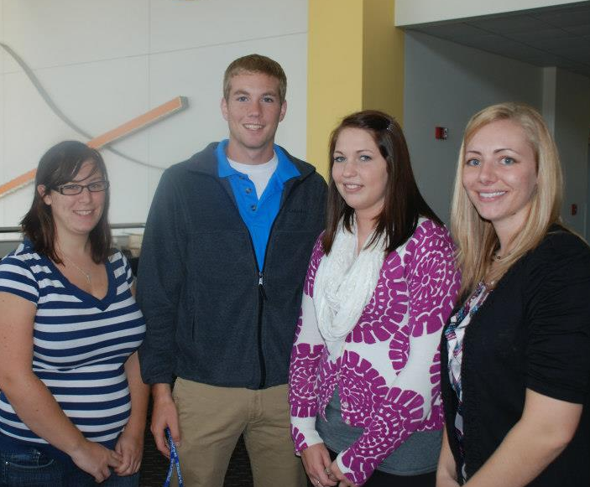
Recruiting Successes
21 former student NAMA members
3 other members under age 25
5 Badger NAMA board members who were in student NAMA

Slide 3
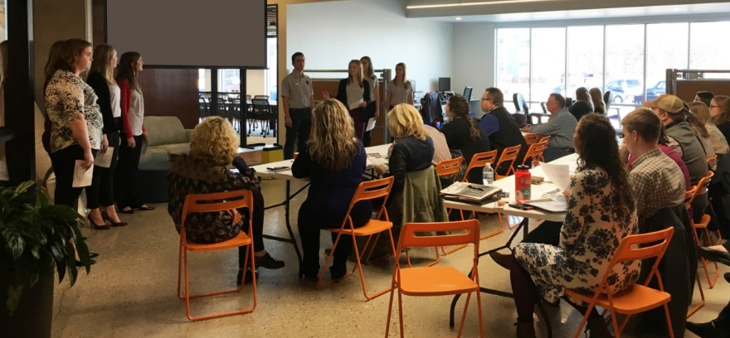
Engaging with Students
One board liaison for each student chapter
Connect students to professionals
Financial support
Notes:
Engaging with students is a priority for us. We have two student chapters within our national chapter: UW-Madison and UW-Platteville.
There is no magic bullet to how we engage with the students, but we attempt to do a few things with our students.
We have designated one board member per student chapter, so they’re getting one-on-one interaction with NAMA chapter leadership.
Our liaisons attend student meetings, provide resume feedback and connect regularly with the student chapter leader.
We also connect students with professionals by encouraging them to attend our chapter events.
Disclosure: it’s not often that they participate in our events, but when they do, they show up in groups and have great questions and networking opportunities.
We host mock judging sessions for the student marking competition taking place here this week. Not only is it an opportunity for them to practice their presentation, but we get to scope out the local up-and-coming talent and we all get the benefit of networking.
3 We provide financial support.
- We offer a fundraising match up to $750 per chapter to contribute to their expenses for the student competition. Our Platteville chapter takes full advantage of this. We like this option because we aren’t just giving away money – they have to make an effort to fundraise themselves and it gives them something more to work toward.
- We offer a travel stipend (up to $250) for them to attend our monthly chapter events. (Note: most don’t take us up on this offer, but we want to remove that barrier if it exists).
And we offer a membership incentive for graduating seniors – we give the student chapter $50 for each student that becomes a professional member (at the national discounted rate when they’re under 25).
All of these financial contributions our chapter makes on its own separate from nationals.

Slide 4
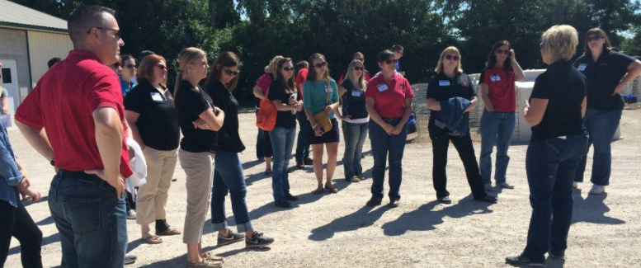
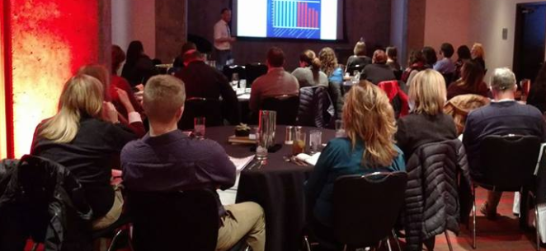
How We Recruit Students
Show students the value of professional NAMA
Event content
Incentives
Financial incentive to join after graduation
Notes:
Our engagement tactics with students are similar to how we recruit them: professional connections and financial incentives.
First, we show them the value of professional NAMA.
- We try to ensure our monthly chapter events have a professional development angle to them. It’s something that we’ve heard from our members in surveys – that they struggle to get approval and/or funding to attend unless there’s professional development involved. While that may not be as attractive to our students, we try to think of them when we’re planning, including the location.
- Then, we offer free or reduced cost to attend professional chapter events.
- We have the travel expense reimbursement I mentioned on the last slide.
- And we do an event for them - We host a student and professional mixer/cocktail hour during World Dairy Expo in Madison.
Second, we offer the financial incentive to join after graduation
- Our Membership chair and student liaisons promote the national NAMA two-year free membership to graduating seniors.
- And, on top of that, each student chapter receives $50 for each graduating senior who joins NAMA directly from our Badger NAMA chapter.

Slide 5
Social Media
Primary form of contact other than email
Facebook events and info sharing
Engage with student chapters
Like us at Facebook.com/BadgerNAMA
Notes:
Social media is a really important tool for our chapter to engage with members.
Facebook is the primary form of contact with our membership outside of email. We’ve tried LinkedIn and a blog and they don’t seem to work as well for us.
As you’ll see here on this chart – this is where our young members are, as well.
-15% of fans are under 25
-43% of fans are 25-34
We post events on Facebook, share content during and after events (including photos), plus industry news.
We also use Facebook to engage with our student chapters by tagging them and inviting their chapters to events.

Slide 6
Questions?
Notes:
One other thing we’d like to note about our younger members…when we were asked to give this presentation we reflected on why we have so many younger members. One thing we thought of that may be a good explanation – though not scientific or proven – is that we have a young board. So when we think of events and content, it may naturally be skewed toward a younger audience. However, we still get a good mix of age participants at our events, so we don’t want to limit our rationale to that, but thought it may be worth mentioning.
Thanks!

