Slide 1
NAMA Member Recruitment Strategic Plan

Slide 2
10 Easy Steps to Building Your Membership Recruitment Strategy
Define your chapter’s current state of membership
Set a SMART (Specific, Measurable, Achievable, Relevant and Time-Bound) goal for May 1, 2023
Pull your Chapter roster report
Of current, active members
Lapsed within last year
Connect with Janae to pull the NAMA Prospect List for your Chapter’s geography & footprint

Slide 3
4. Share the report with Chapter Leadership
Before the next Chapter leadership meeting, have leaders review, reflect and then email
A list of companies that are missing representation (from within the Chapter footprint); think about companies big and small, start-ups, accelerators, agencies, media, associations, growers/producers, etc. Designate one person to compile the list before the next Chapter leadership meeting
5. On agenda of next Chapter leadership meeting, review as a group the full list of submissions
6. Prioritize the list into thirds: 1) High 2) Medium and 3) Low. Think about location/geography, marketing department influence & location, does someone have a contact to start with, and ROI for the work you will put in

Slide 4
Force rank the High list from 1- x; Assign a leader to each company
Leverage Resources from NAMA website to create an introduction letter/email or LinkedIn messenger outreach
Who is NAMA? Who are you? Who is the Chapter leadership team?
What does NAMA do for the industry? What is the mission of the Chapter?
What could NAMA do for people leadership and development opportunities within their company?
When, Where and How frequently does the Chapter meet?
How is the Chapter affiliated and connected to National NAMA?
How do I become a member?

Slide 5
Set a deadline to report back to the entire Chapter Leadership Team
10. Repeat for Medium list (only if a part of your goals; otherwise, maintain list for next year’s Chapter leaders to refer to.)

Slide 6
Resources and Tools to aid in Building Your Membership Recruitment Strategy
Janae contact information
Manager, Chapter & Student Services
Your NAMA Exec Committee member
The NAMA Website:https://www.nama.org/
This 10 Step Process
The NAMA Brand Deck

Slide 7
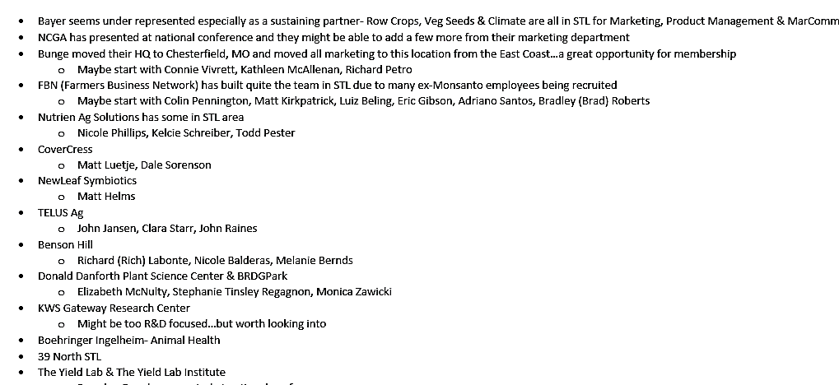
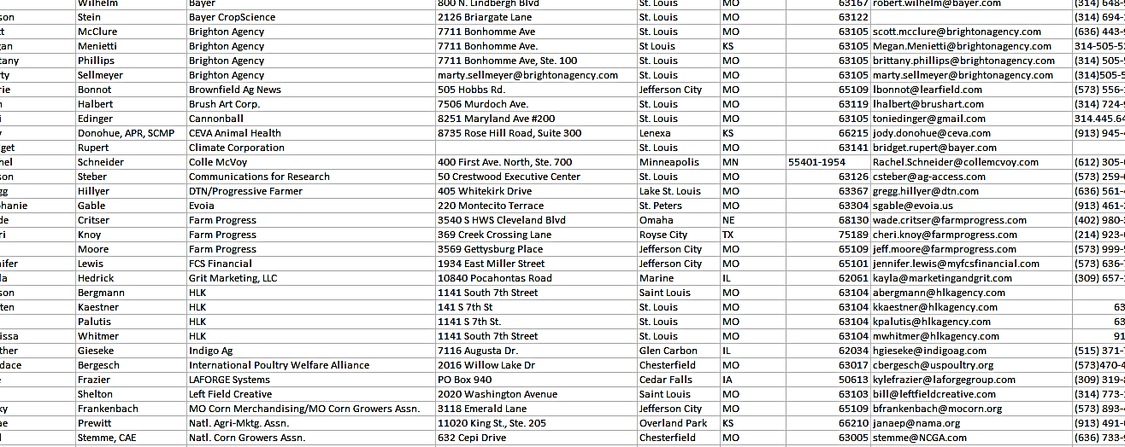
Gateway Chapter Case Study
Janae to coordinate and have them go through steps 1-10
Top Prospect List
Event Invitation to Experience NAMA Chapter
Outreach Email/Phone/LinkedIn
Top Prospect List Assignments

